Slide 1
Unit 4
Real time operating systems

Slide 2
2.Kernel space and user space
Application service classified in two sections
User application
Kernel application
User application: are loaded to specific area of primary memory and this referred as user space
Kernel application: the program code corresponding to kernel application service are kept in a contiguous area of primary and protected from authorized access by user

Slide 3
3. Monolithic kernel
In this all kernel services run in kernel space which all modules runs with in same memory space under single kernel module leads to crashing of entire kernel application
Ex:. Linux , Solaris , ms -dos

Slide 4
4.Micro kernel
It incorporated only essentially set of operating systems services in to kernel
The rest of operating systems services are implement In programs known as service which run user in user space
The memory management, process management, time systems and interrupts handler are essential services which form part of kernel micro.
Eg: Mach , qnx, minix3 kernel

Slide 5
Benefits of micro kernel
Robustness : if a problem is encounter in any services which runs server application the same can be configured and restart with out need for restarting the entire OS.
Configurability: any services which run as server application can be changed without the need to restart the whole system

Slide 6
Types of operating systems
A) general purpose operating system :
Used for general computing system the kernel of such an operating system is generalized and it contains all kinds of services required for executing generic application
Eg: personal computers / desktops Systems

Slide 7
B) Real Time Operating Systems :
Real time implies as deterministic time behavior
Deterministic time behavior means the operating systems services consumes only known as expected amounts of time regardless the number of services
An real time operating system (or) RTOS implement policies and rule concerning time critical allocation of a system

Slide 8
RTOS decide which application should run in which order and how much time need to allocate for each application
Predictable performance is hallmark of well designed RTOS
Eg: Windows CE , Qnx, Vx, works micro / os-II etc.,

Slide 9
I) The real time kernel :
The kernel is highly specialized and it contains only the minimal set of services required for running the user / application / task.
Functions are as follows :
I) task /process management
Ii) task/ process scheduling
Iii) task / process synchronization
Iv) error / exception handling
V) Memory management
Vi) Interrupt handling
Vii) Time management

Slide 10
I) task / process management
Deal with setting up memory space for task loading the task code in to memory space allocating system resources , setting up task control block (TCB) , used for holding information corresponding to task which contain following set of information .
1. Task Id: Task identification
2. Task state : the current state of task ( ready to execute)
3. task type : indicates type of task

Slide 11
4. Task priority : task priority ( 1 or 0 )
5. Task content pointer : context pointer , pointer of context saving
6. Task memory pointer : pointer to code memory's data , stack memory
7. Task system resources pointer : pointer to system resources
8. Task pointer : pointer to Tsb ( next wait task)
9. Other parameters : other relevant task parameters

Slide 12
Utilities of TSB ( Task control Block) :-
Create TSB for tasking and creating task
Delete / remove task for ( TSB)
Reads the TSB to get state of task
update the TSB with updated parameters on need basis
Modify TSB to change the priority of task dynamically

Slide 13
Task / process scheduling
Deals in sharing the CPU among various task / process
A kernel application is called scheduler handler task scheduling
Scheduler is algorithm implementation performs the efficient optimal scheduling of task to provide a deterministic behaviour

Slide 14
Task / process synchronization
Deals with synchronization the concurrent access of resources which is shared across multiple tasks and communication between various task

Slide 15
Error / exception handling
Deals with registering and handling the errors occurred / exception raised during the exception of task insufficient memory , time out , dead locks , deadlines missing, bus error , divide by zero , unknown instructions execution
Dead lock is example for kernel exception
Time out is example for kernel exception

Slide 16
Handling
Watch dog timer is a mechanism for handling the time outs for task certain task may involve the waiting of external from devices
These task will wait infinitely when external device is not responding and task will generate a hangup behaviour
To avoid proper scenarios mechanism should be implemented

Slide 17
Interrupt handler
Deals with various types of interrupts
Interrupts provides various types of behavior in systems
Interrupts can either be synchronous or asynchronous
Software interrupts fall under synchronous interrupts
Ex: divided by zero , segmentation error .

Slide 18
Asynchronous interrupts are interrupts which occur at any point of execution of task and are not in synchronization with current task
The interrupts generated by external devices connected to processor / controller ,time over flow interrupts, serial data reception are transmission interrupts etc.
For asynchronous interrupts ,the interrupts handler is usually written as separate task and it runs different context.

Slide 19
Memory management
Compare to GPOS , kernel is slightly different
In general memory allocation time increase depending on size of memory needs to be allocated and state of memory block
RTOS make use of block based memory allocation technique instead of usual dynamic memory allocation technique used by GPos
RTOS kernel is uses block of fixed size of dynamic memory and block is allocated for a task on need basis

Slide 20
RTOS kernel allows tasks to access any of memory block with out any memory protection
A few RTOS implement virtual memory concept for memory allocation if the systems support secondary memory storage ( like HM and flash memory )
In a block based memory allocation a block of fixed memory is always allocated for tasks on need basis and taken as a unit

Slide 21
Time management
Accurate time management is essentially for providing time reference for all applications.
Time refer to kernel is provided by high resolution real time clock (RTC) hardware chip ( hardware timer) .
The hardware is programmed to interrupt the processor / controller at fixed rate .
This interrupt is referred as timer tick' .
The timer thick is taken as timing reference by kernel

Slide 22
II) Hard real time
RTOS sticktly adheres to time constriants for task is reffered as HARD real TIME.
Hard real time should meet deadlines for task without slippage.
Missing any dead line may produce catastropic results for hard real time systems
It has principle ‘A late answer is wrong answer’.
To correct there operational line it should meet their time constraints.

Slide 23
III) Soft real time
Real time that does not grantee meeting deadlines but offers best effort to meet the deadline are referred as soft real time system
Missing deadline are acceptable to meet soft real time if frequency of deadline missing with in compliance limit and quality of service.

Slide 24
3. Tasks , process & Threads
Task refers as something to be done .
Task is also known as Job in operating system context .
A program are a part of execution is also called as process .
Process :
Process is a program or part of it in execution and also known as instance of program in execution.

Slide 25
i) The structure of process
Process leads to concurrent execution (pseudo parallelism) of tasks and there by efficient utilization of CPU and other resources
Concurrent execution is archived by sharing of CPU among the process

Slide 26
Structure of process
pr
PROCESS
Stack pointer
Working register
Status register
Program counter
Code memory corresponding to process

Slide 27
A process in which inherits all properties of the CPU can be consider as virtual processer awaiting its turn to have its properties switched in to physical processor
when a processor gets its turn its register and program counter get mapped to physical register of CPU
Memory occupied is segregated in 3 terms
A) stack memory
B) Data memory
c) code memory

Slide 28
Memory organization of a Process
Stack memory holds all temporary data such as variables local to the process.
Data memory holds all global data for the process.
The code memory contains the program code corresponding to the process.
Stack Memory
Stack Memory grows downwards
Data Memory grows upwards
Data Memory
Code Memory

Slide 29
Process states and State transitions
Creation to termination of a process is not a single step operation.
The cycle through which a process changes its state from ‘newly created’ to ‘execution completed’ is known as ‘Process Life Cycle’.

Slide 30
Created
Incepted into memory
Ready
I/O completion
Interrupt or preempted
Shared resource acquired
Blocked
Scheduled for execution
Waiting for I/O
Running
Waiting for shared resource
Execution completion
Completed

Slide 31
Threads
Thread is the primitive that can execute code. It is a single sequential flow of control within a process also known as light weight process.
A process can have many threads of execution.
Different threads which are part of a process, share the same address space; meaning they share the data memory, code memory and heap memory area.
Threads maintain their own thread status (CPU register values), Program Counter (PC) and stack.

Slide 32
Memory organization of a process and its associated threads
Stack memory for Thread 1
Stack memory for Thread 2
Stack Memory for process
Data memory for process
Code memory for process

Slide 33
Multithreading
A process/task in embedded application may be a complex or lengthy one and it may contain various sub operations like getting input from I/O devices connected to the processor, performing some internal calculations/operations, updating some I/O devices etc.
If all the sub functions of a task are executed in sequence, the CPU utilization may not be efficient.

Slide 34
Task Process
Code memory
Data memory
Stack
Stack
Stack
Registers
Registers
Registers
Thread 1
Thread 2
Thread 3
Create child thread 1
Child thread 1
Child thread 2
Create child thread 2

Slide 35
Thread Pre-emption
Thread pre-emption is the act of pre-empting the currently running thread( stopping the currently running thread temporarily).
Thread pre-emption is performed for sharing the CPU time among all the threads.
The execution switching among threads are known as ‘Thread context switching’.

Slide 36
Types of Threads
1. User Level Thread
2. Kernel/ System Level Thread
User Level Thread:
Do not have kernel/Operating system support and they exist solely in the running process.
Even if a process contains multiple user level threads, the OS treats it as single thread and will not switch the execution among the different threads of it.
It is the responsibility of the process to schedule each thread as and when required.
Non-preemptive at thread level from OS perspective.

Slide 37
Types of Threads
Kernel/ System Level Thread:
Kernel level threads are individual units of execution, which the OS treats as separate threads.
The OS interrupts the execution of the currently running kernel thread and switches the execution to another kernel thread based on scheduling policies implemented by the OS.
These are pre-emptive.

Slide 38
For user level threads, the execution switching happens only when the currently executing thread is voluntarily blocked.
No OS intervention and system calls are involved in the context switching of user level threads. This makes context switching of user level threads very fast.
Kernel level threads involves lot of kernel overhead and involve system calls for context switching.

Slide 39
Thread binding models
There are many ways for binding user level threads system/ kernel level threads. They are
Many-to- One Model:
Many user level threads are mapped to a single kernel thread.
Kernel treats all user level threads as single thread and the execution switching among the user level threads happens when a currently executing user level thread voluntarily blocks itself or relinquishes the CPU.

Slide 40
Thread binding models
One-to-One Model:
Each user level thread is bonded to a kernel/system level thread.
Many-to-Many Model:
Many user level threads are allowed to be mapped to many kernel threads.

Slide 41
Multiprocessing and Multitasking
The ability to execute multiple processes simultaneously is called multiprocessing
Systems which are capable of performing multiprocessing, are known as multiprocessor systems. Multiprocessor systems posses multiple CPU’s and can execute multiple processes simultaneously.
The ability of the operating system to have multiple programs in memory, which are ready for execution, is referred as multiprogramming.

Slide 42
Multitasking
In a uniprocessor system, it is not possible to execute multiple processes simultaneously but can be achieved by switching the execution among different processes.
The ability of an OS to hold multiple processes in memory and switch the processor from executing one process to another process is called multitasking.
Multitasking creates the illusion of multiple tasks executing in parallel.

Slide 43
Multitasking
Process is considered as a virtual processor, awaiting its turn to have its properties switched into physical processor.
Switching of virtual processor to physical processor is done by scheduler of the OS kernel.
Whenever a CPU switching happens, the current context has to be saved to retrieve it at a later point of time when the CPU executes the process, which is interrupted due to execution switching.

Slide 44
Multitasking
The act of switching CPU among the processes or changing the current execution context is known as ‘Context Switching’.
The act of saving the current context which contains the context details( Register details, memory details, system resource usage details, execution details, etc.) for the currently running process at the time of CPU switching is known as ‘Context saving’.
The act of retrieving the saved context details for a process, which is going to be executed due to CPU switching, is known as ‘Context retrieval’.

Slide 45
Types of Multitasking
Depending on how the switching act is implemented, multitasking can be classified into different types. They are
Co-operative multitasking:
Most simple form of multitasking in which tasks/process gets a chance to execute only when the currently executing task/process voluntarily relinquishes the CPU.
In this type any task/process can hold CPU as much time it wants.

Slide 46
Types of multitasking
Preemptive multitasking:
Ensures that every task/process gets a chance to execute.
When and how much time a process gets is dependent on the implementation of the preemptive scheduling.
The preemption of task may be based on time slots or task/process priority.

Slide 47
Types of multitasking
Non-preemptive multitasking:
The process/task, which is currently given the CPU time, is allowed to execute until it terminates or enters the ‘Blocked state’ waiting for an I/O or system resource.
The co-operative and non-preemptive multitasking differs in their behavior when they are in the ‘Blocked/wait state’.

Slide 48
Task scheduling
There should be some mechanism in place to share the CPU among the different tasks and to decide which process/task is to be executed at a given point of time.
Determining which process/task should be executed at a given point of time is known as task/process scheduling.

Slide 49
Task scheduling
The process scheduling decision may take place when a process switches its state to
1. ‘Ready state from ‘Running’ state
2. ‘Blocked/wait state from ‘Running’ state
3. ‘Ready’ state from ‘Blocked/wait’ state
4. ‘Completed’ state

Slide 50
Selection of scheduling algorithm
The selection of a scheduling algorithm should be consider the following factors:
CPU Utilization:
The scheduling algorithm should always make the CPU utilization high. CPU utilization is a direct measure of how much percentage of the CPU is being utilized.
Throughput:
Number of processes executed per unit of time. It should be higher.

Slide 51
Turnaround Time:
It is the amount of time taken by a process for completing execution.
It includes the time spent by the process for waiting for main memory, time spent in the ready queue, time spent on completing I/O operations, and the time spent in execution.
Turnaround time should be minimal for a good scheduling algorithm.

Slide 52
Waiting Time:
It is the amount of time spent by a process in the ready queue waiting to get the CPU time for execution.
Waiting time should be minimal for a good scheduling algorithm.
Response Time:
It is the time elapsed between the submission of a process and the first response.

Slide 53
Queues
Operating system maintains various queues in connection with CPU scheduling, and a process passes through these queues during the course of its admittance to execution completion.
Job queue:
Contains all the processes in the system.
Ready queue:
Contains all the processes, which are ready for execution and waiting for CPU to get their turn for execution.

Slide 54
Queues
Device queue:
Contains the set of processes, which are waiting for an I/O device.

Slide 55
Types of scheduling
Non-preemptive scheduling:
Systems which implement non-preemptive multitasking model.
In this type of scheduling the currently executing task/process is allowed to run until it terminates or enters the ‘wait’ state waiting for an I/O or system resource.
The various types of non-preemptive scheduling algorithms are
1.FCFS/FIFO: First Come First Service
2.LCFS/LIFO: Last Come First Service
3.SJF scheduling: Shortest Job First
4.Priority based scheduling

Slide 56
Non-preemptive scheduling algorithm
First-Come-First-Served(FCFS)/FIFO Scheduling:
Allocates CPU time to the processes based on the order in which they enter the ‘Ready’ queue.
The major drawback of FCFS algorithm is that it favors monopoly of process.

Slide 57
Non-preemptive scheduling algorithm
Last-Come-First Served (LCFS)/LIFO Scheduling:
Allocates CPU time to the processes based on the order in which they are entered in the ‘Ready’ queue.
The last entered process is serviced first.
Shortest Job First (SJF) Scheduling:
‘Sorts’ the ‘Ready’ queue each time a process hand over the CPU to pick the process with shortest estimated completion/run time.

Slide 58
Non-preemptive scheduling algorithm
The average time for a given set of process is minimal in SJF scheduling and so it is optimal compared to other non-preemptive scheduling like FCFS.
Major drawback of this algorithm is that a process whose estimated execution time is high may not get the chance to execute if more and more processes with least estimated execution time enters the ‘Ready’ queue before the process with longest estimated execution time started its execution, called ‘Starvation’.

Slide 59
Non-preemptive scheduling algorithms
Another drawback of SJF is that it is difficult to know in advance the next shortest process in the ‘Ready’ queue for scheduling since new process with different estimated time keep entering the ‘Ready’ queue at any point of time.
Priority Based Scheduling:
Priority based non-preemptive scheduling algorithm ensures that a process with highest priority is served first.
SJF is also an priority based scheduling algorithm.
Starvation is present. Can be eliminated by raising priority as time progresses, called ‘Aging’.

Slide 60
Preemptive scheduling
Preemptive scheduling is employed in systems, which implements preemptive multitasking model.
Every task in ‘Ready’ queue gets a chance to execute.
When and how each process gets a chance to execute is dependent on scheduling algorithm.
The act of moving a ‘Running’ process/task into the ‘Ready’ queue by the scheduler, without the process requesting for it is known as ‘Preemption’.

Slide 61
Preemptive scheduling
Two different approaches for preemptive scheduling are
Time based preemption and
Priority based preemption.
Preemptive SJF scheduling/ Shortest Remaining Time:
Incase of non-preemptive SJF algorithm sorts the ‘Ready’ queue only after completing the execution of current process.
Whereas in preemptive SJF algorithm sorts the ‘Ready’ queue when a new process enters into the queue and compare the currently executing process time and if the execution time of new process is shorter then currently executing process is preempted and the new process is scheduled for execution.

Slide 62
Preemptive scheduling
Round Robin (RR) scheduling:
Similar to FCFS but here the time slot based preemption is added to switch between processes in the ‘Ready’ queue.
Process 1
Process 2
Process 3
Process 4
Execution switch
Execution switch
Execution switch
Execution switch

Slide 63
Preemptive scheduling
Priority based scheduling:
Same as that of non-preemptive priority based scheduling except for the switching of execution between the tasks.
In preemptive scheduling as the highest priority process enters it will be immediately scheduled for the execution.

Slide 64
Threads, Processes, Scheduling altogether
Lets assume that we have two process for execution namely Process1 with normal priority and Process 2 with highest priority.
Process1 requires 7.5 units of execution time and after this it will sleep for 17.5 units of execution time and repeated forever.
Process2 requires 10 units of execution time and after this it will sleep for 5 units of execution time and repeated forever.

Slide 65
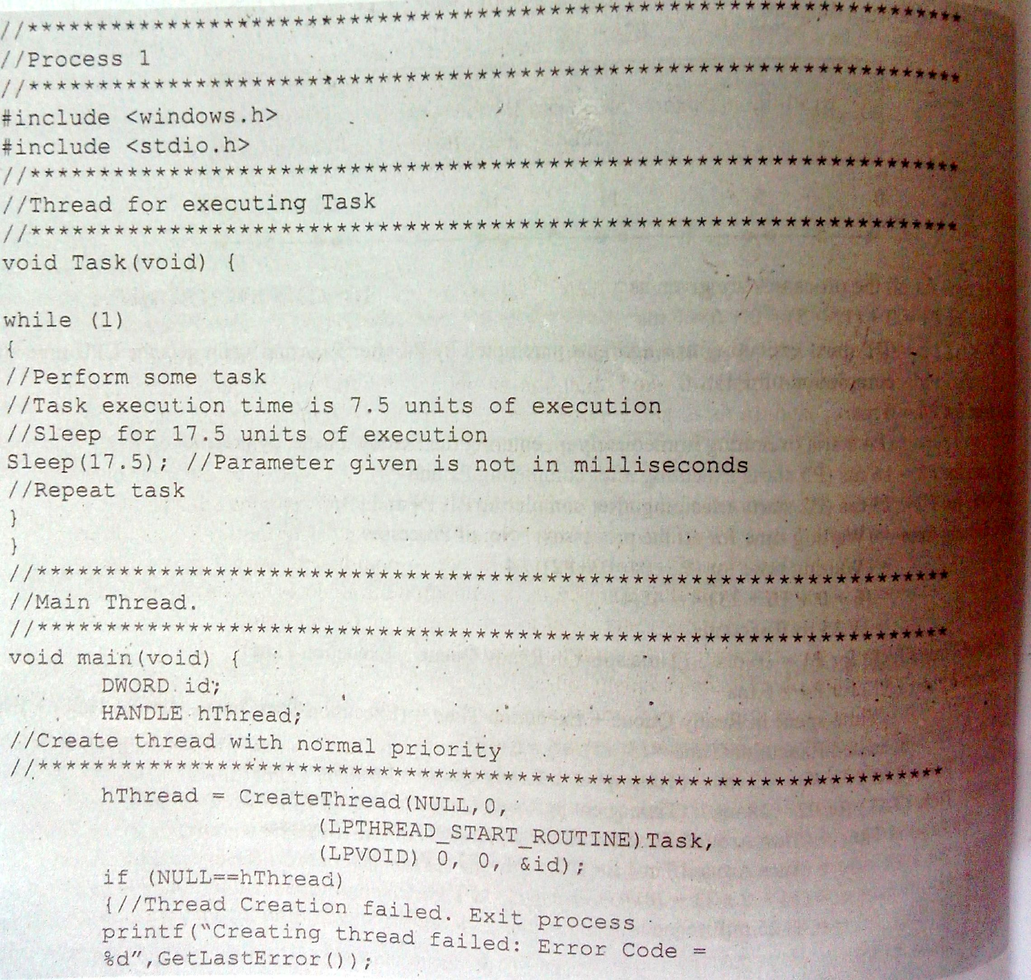

Slide 66
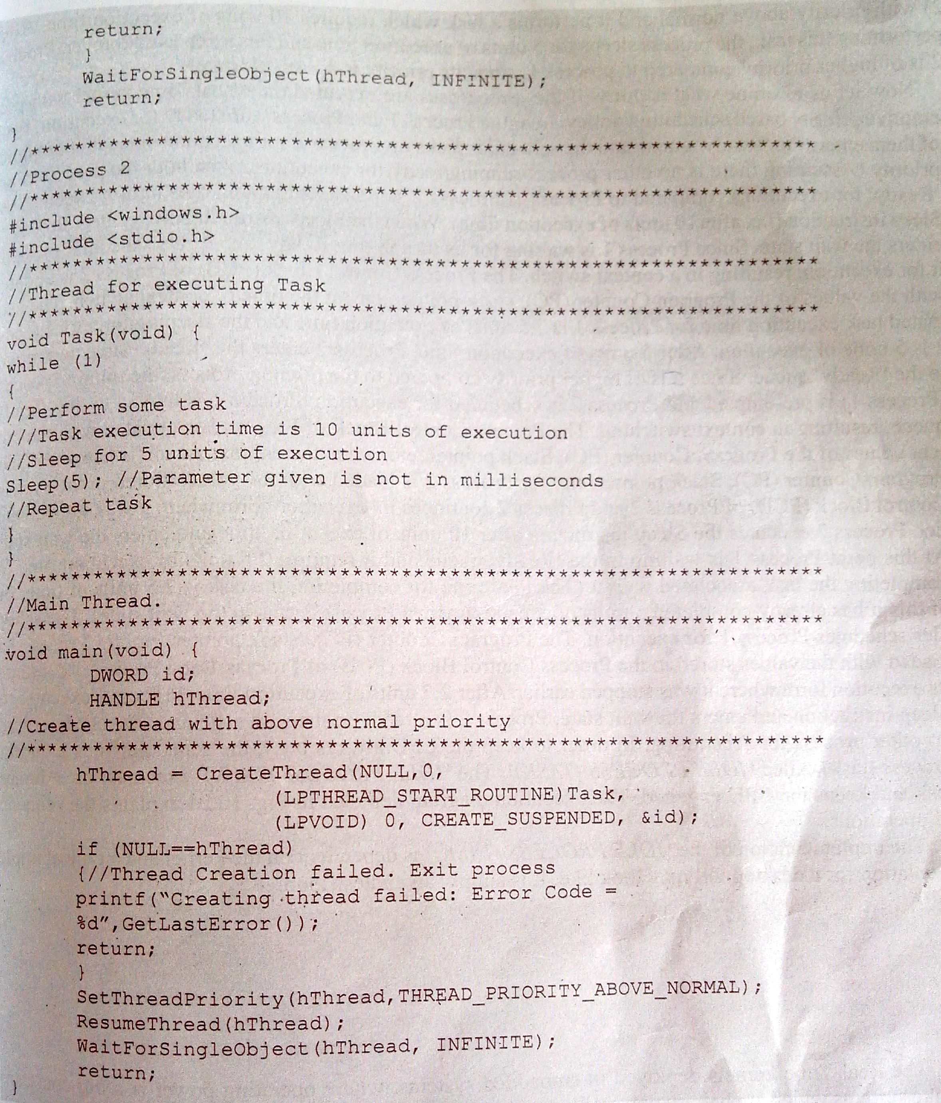

Slide 67
Threads, Processes, Scheduling altogether
Working in Real-Time Kernel with preemptive priority based scheduling policy:
Process1 and Process2 are ready for execution and enters the ready queue and the scheduler picks the Process2 for execution because it is having above normal priority.
Process2 starts executing and runs until it executes the sleep instruction (i.e. after 10 units of execution time).

Slide 68
Threads, Processes, Scheduling altogether
When the Process2 executes the sleep instruction it goes into the wait state.
Process1 is waiting for its turn and the scheduler picks it for execution, resulting in a context switching.
Process Control Block(PCB) of Process2 is updated with the values of PC, SP, etc. at the time of context switching.
As the Process1 executing time is of 7.5 units and the Process2 sleep time is 5 units of execution.

Slide 69
Threads, Processes, Scheduling altogether
After 5 units of execution time, Process2 enters the ready state and to the ready queue.
Since Process2 is with highest priority, scheduler picks it for execution and the currently running process1 is preempted.
Process1 moves into the ready queue resulting in a context switching. PCB of Process1 will be updated by the PC, SP values.

Slide 70
Threads, Processes, Scheduling altogether
PC, SP etc. for Process2 is loaded with the values previously stored in PCB of Process2 and continues the execution from where it has stopped.
Process2 executes the sleep instruction after 10 units of execution time and enters the wait state.
At this point the process1 is waiting in the ready queue and it requires 2.5 units of execution time for completing the task associated with it. Scheduler schedules Process1 for execution.

Slide 71
Threads, Processes, Scheduling altogether
PC, SP etc. for process1 is loaded with the previously stored values in PCB of Process1 and continues from where the execution stopped.
After 2.5 units of execution time, process1 executes the sleep instruction and enters wait state.
Process2 is already in the wait state and scheduler finds no other process for scheduling.

Slide 72
Threads, Processes, Scheduling altogether
In order to keep the CPU always busy, the scheduler runs a dummy process/task called ‘IDLE PROCESS (TASK)’.
Void Idle_Process (void)
{
//simply wait..
//do nothing..
While(1);
}

